Slide 1
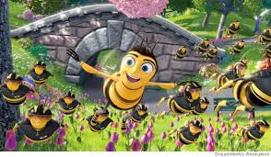
Correlation Between Decrease in Bee Colony/Bee Population and Factors Related to Rising Industrialization
If we die, we’re taking you with us
The Bees

Slide 2


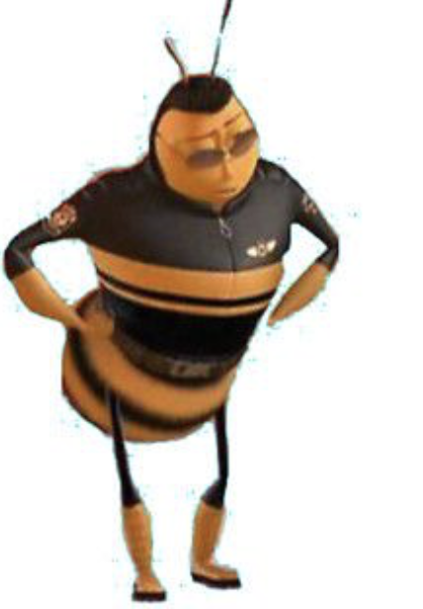


Project Team
David Romaine
Marcel Walker
Sherwin Macalinta
Kathy Cashen

Slide 3

Why Bees?
Since the late 1990s, beekeepers around the world have observed the mysterious and sudden disappearance of bees, and report unusually high rates of decline in honeybee colonies.
Bees make more than honey – they are key to food production because they pollinate crops.
A third of the food that we eat depends on pollinating insects: vegetables like zucchini, fruits like apricot, nuts like almonds, spices like coriander, edible oils like canola, and many more…
In Europe alone, the growth of over 4,000 vegetables depends on the essential work of pollinators.
But currently, more and more bees are dying.
The bee decline affects mankind too. Our lives depend on theirs.
Source :http://sos-bees.org/situation/

Slide 4
What Do the Specialists Think?
Colony collapse disorder leapt into headlines after a bad winter in 2006-07. It was dramatic, mysterious and unprecedented. Beekeepers and farmers sounded the alarm: The bees are disappearing
Colony Collapse Disorder is the phenomenon that occurs when the majority of worker bees in a colony disappear and leave behind a queen, plenty of food and a few nurse bees to care for the remaining immature bees and the queen
Lately, beekeepers have been attributing more of their losses to problems with queen bees. They’re not living as long, usually because they run out of sperm supplies too early. It’s unclear why
Click here to learn more about queen bee sperm than you probably really wanted to know
There’s no one answer. But there are a lot of different theories….
here are ours

Slide 5

Hypothesis ( AKA Questions We’re Trying to Answer)
Are bees really dying out?
Can we relate the bee die out to a rise in industrialization?
Does climate affect the bee die out?
What if it’s cell phones??
Is it too late to save the bees?!?

Slide 6

Overview of Bee Data Kathy Cashen

Slide 7
Bee Informed Partnership
The Bee Informed Partnership is a collaboration of efforts across the country from some of the leading research labs and universities in agriculture and science to better understand honey bee declines in the United States.
One of the Bee Informed Partnership’s major focuses is to bring together several disciplines to study ways to keep honey bee colonies healthy. One way we try to help all beekeepers is by conducting annual surveys and sharing the results with the beekeeping community. Our flagship service, The Bee Informed National Management Survey, reflects this goal.
https://beeinformed.org/
a hive of information
Notes:
After vetting numerus data sets from multiple sources, we looked at data from the Bee Informed Partnership . Bee Informed has survey results from 2006 to 2018, and will survey for 2019.
Sadly, the USDA has reported that due to budgetary constraints, they will no longer gather honey bee data in their agriculture survey.

Slide 8
Our Bee Data
Data is reported at a managed colony level
estimated 2.74 million managed colonies in the USA
Average number of survey respondents is 5,900 collectively managing ~414,000 colonies
2 data sets
2011-2014 as baseline with 50 states reporting
2014-2018 as primary focus with 45 states reporting
2015-2018 mean for bee colony loss across the US is 43%
UP from 2011-2014 mean loss of 41%
Reflects a 10 year high!
Max loss for 2015-2018 lower than previous period
71% (Arizona) vs 82% (D.C)
Min loss 2015 – 2018 higher than previous period
27% vs 17% ( both Hawaii)
But don’t bees die in the in winter anyway?
NOT ALL Bees!
The accepted average winter die off is only 16%
Though previously it was closer to 10%
https://americanbeejournal.com/beekeeping-by-the-numbers-2/
Notes:
Data is reported at a managed colony level and not on an individual level so we ‘re talking about anywhere from 50k to 80k bees per hive https://www.buzzaboutbees.net/honeybees.html
1 queen
50,000 workers
300 drones
9000 larvae
20,000 older larvae and pupae in sealed cells
6000 eggs
We’re also not talking about wild honey bees
2 data sets
2011-2014 as baseline with 50 states reporting
2014-2018 as primary focus with 45 states reporting – where we lost DC, Nevada, Rhode Island, New Hampshire, and Delaware – the dangers of using survey data, and
What about Alaska? More than nine million European Honey Bees are imported into Alaska each year for honey production. These bees play a significant role in pollinating Alaska's crops and wild lands. Most European Honey Bees cannot survive through Alaska's cold winters.

Slide 9
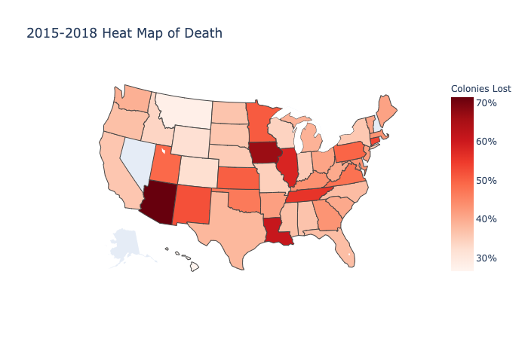
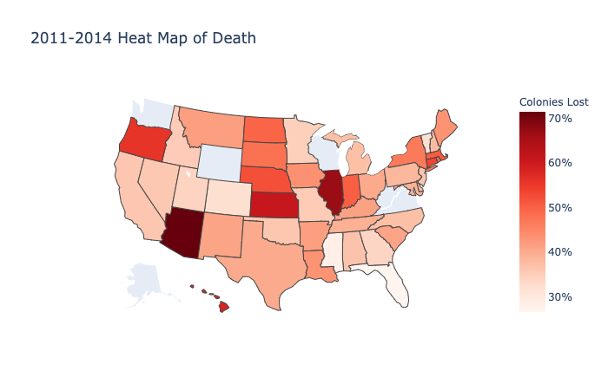
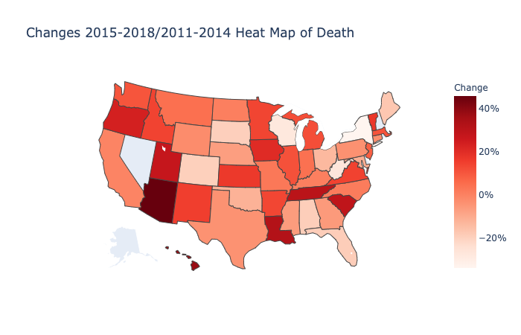
Heat Maps of Death
17 States show improvement
62% decline

Slide 10
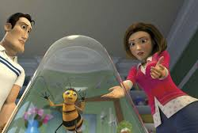
Bees and the Human Factor – Sherwin Macalintal

Slide 11
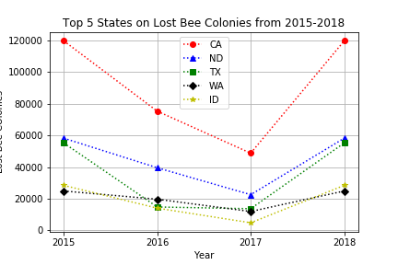
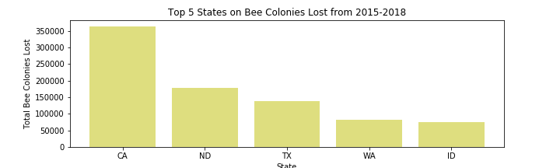
Top 5 States based on Total Loss of Bee Colonies

Slide 12
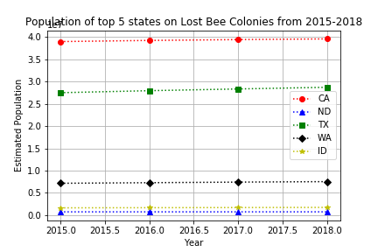
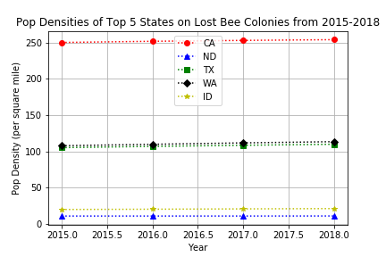
Top 5 States on Lost Bee Colonies
vs. Population

Slide 13
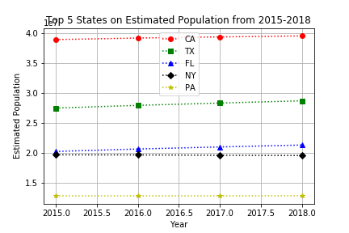
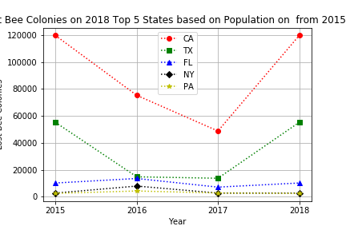
Top 5 States on Population vs. Lost Bee Colonies

Slide 14
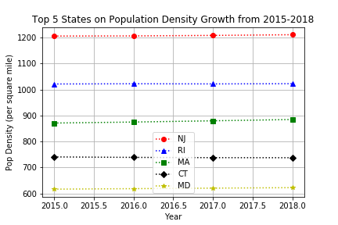
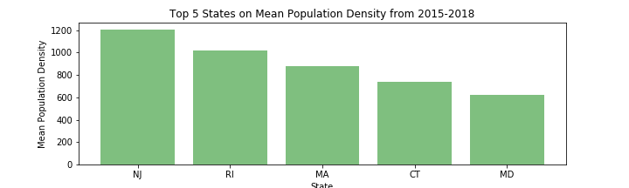
Top 5 States on Population Density vs. Lost Bee Colonies

Slide 15
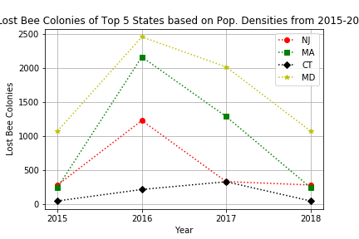
Top 5 States on Population Density vs. Lost Bee Colonies
Note: RI does not have records of Lost Bee Colonies

Slide 16
Bees and Human Population Density
Using independent T-test:
Top 20 states vs. bottom 20 states by population density
p-value = 3.21009902995104e-05
Since this p < 0.05,
the difference in the means is significant

Slide 17

Bees and Weather – Marcel Walker

Slide 18
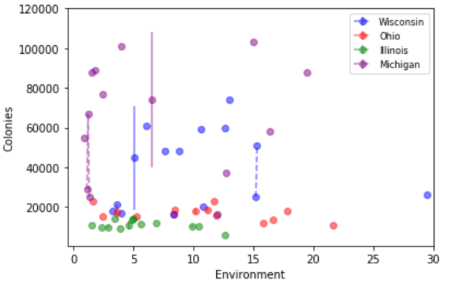
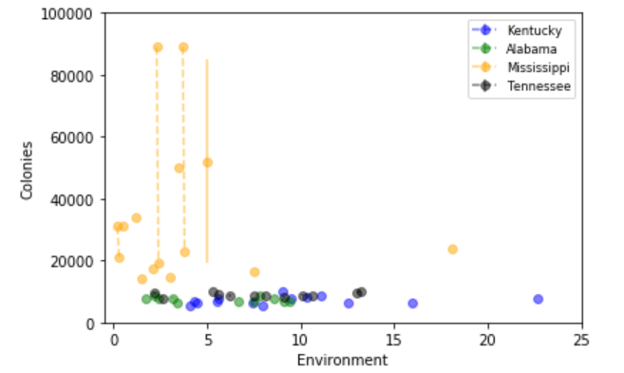
Comparison of hot and cold environments touching water- similar survival rate
East North Central – Cold touching water
East South Central – Hot touching water
East South Central
East North Central

Slide 19
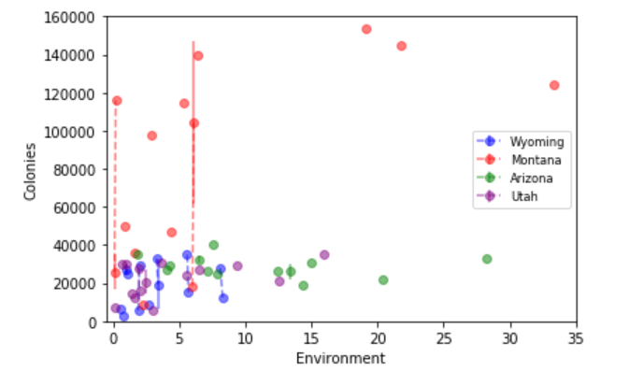
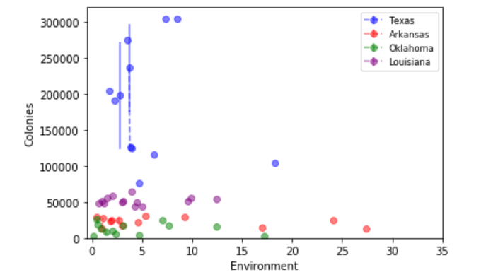
Comparison on mountain and green states- 2x higher survival rate in the hot region
Mountain- cold not touching the ocean
West Central South Region – Hot touching the ocean
Mountain
West Central South

Slide 20
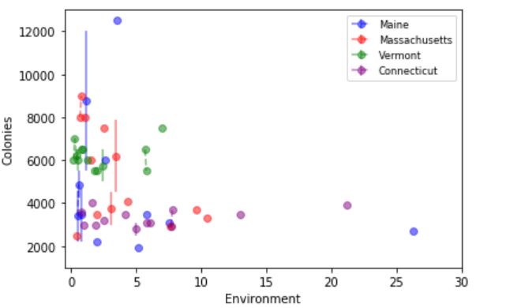
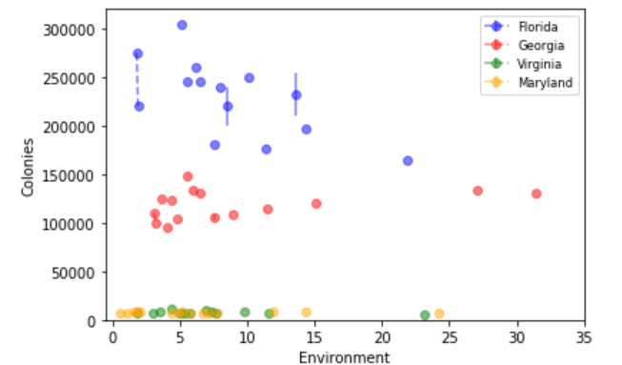
Comparison of cold and hot states touching mostly touching water – 35x higher survival rate in the hot region
New England Region – Cold touching water
South Atlantic Region – Hot touching water
New England
South Atlantic

Slide 21
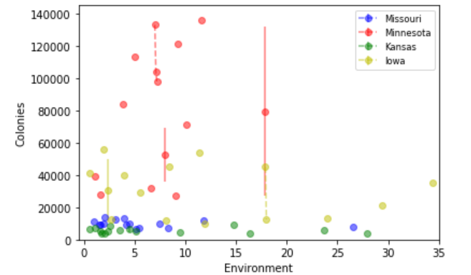
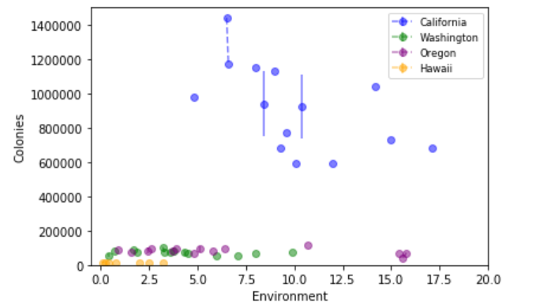
Comparison of regions hot mostly touching water and cold mostly not touching water- 35x higher survival rate in the hot area touching water
Midwest – mostly not touching water
Pacific – mostly touching water
Midwest
Pacific

Slide 22
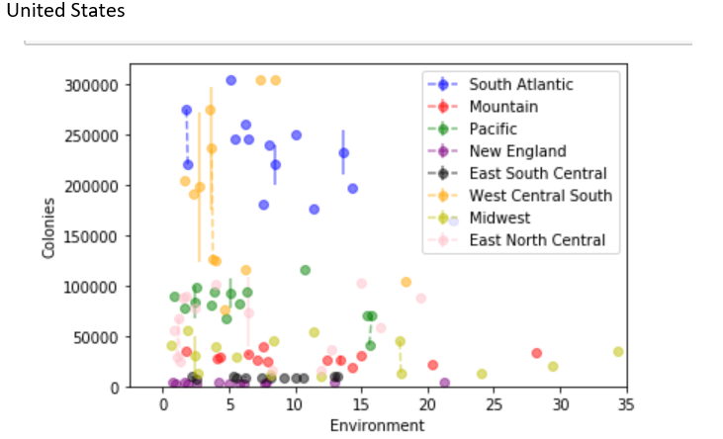
United States comparing all regions
All states

Slide 23
Conclusions
Based on research, the environment has a large impact the survival of the bee population.
Bees seems to be more attracted to the areas closer to the ocean and large lakes whether cold or hot.
Temperature seems to play a factor on the bee population also; bees seem to have a higher survival rate in areas with hot temperatures and closer to water

Slide 24

YOUR CELLPHONE

Slide 25
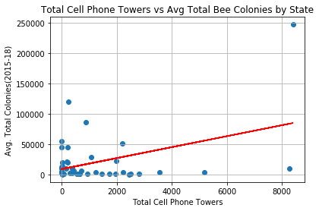
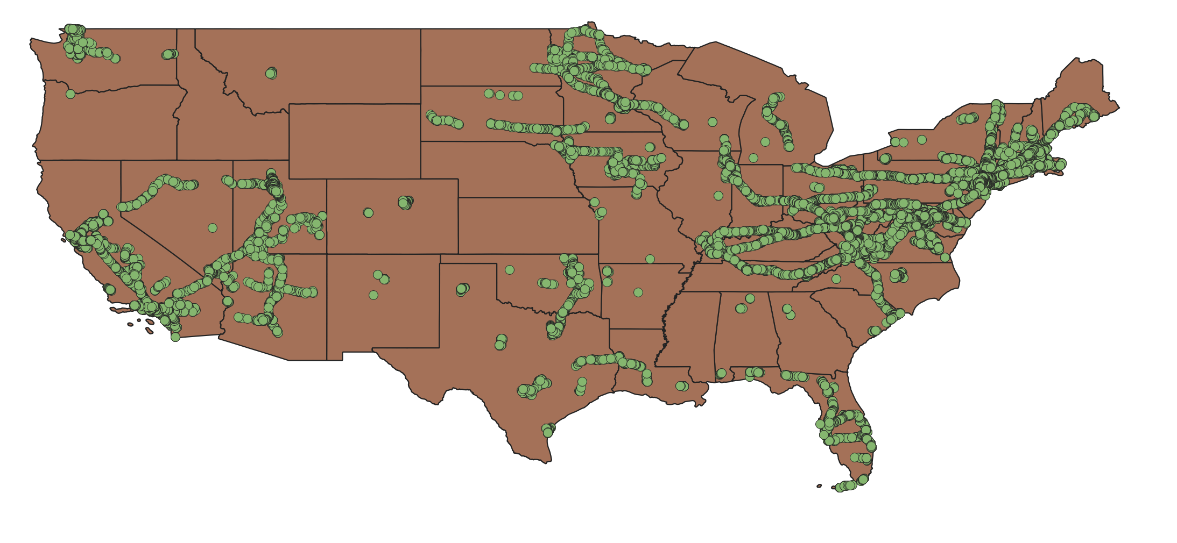
Total Cell Phone Towers vs Avg Total Bee Colonies by State
Graph: Total Cell Phone Towers vs Avg Total Bee Colonies by State
Null Hypothesis: The more towers a state has the more bee colonies will be present.
Alternative Hypothesis: The more towers a state has the less bee colonies will be present.
Results- The correlation test yielded a line of best fit with a positive slope of .41 with a p-value of .0058. Based on these results we fail to reject the null hypothesis.

Slide 26
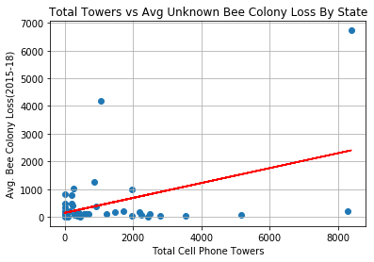
Total Towers vs Avg Unknown Bee Colony Loss By State
Null Hypothesis: The more towers a state has the less the average total loss due to unknown causes will be.
Alternative Hypothesis: The more towers a state has the greater the total loss due to unknown causes will be.
Results: The correlation test yield a line of best fit with a positive slope of 0.44 and a p-value of 0.03. Based on these results we reject the null hypothesis.

Slide 27
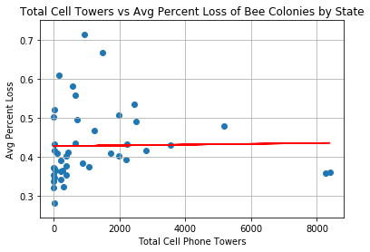
Total Cell Towers vs Avg Percent Loss of Bee Colonies by State
Graph: Total Cell Towers vs Avg Pct Loss of Bee Colonies by State
Null Hypothesis: The more towers a state has the lower percent loss the state will have on average.
Alternative Hypothesis: The more towers a state has the greater percent loss the state will have on average.
Results: The correlation test yielded a line of best fit with a positive slope of 0.02 with a p-value of 0.89. Based on these results we fail to reject the null hypothesis.

Slide 28
Conclusions
Based on the cell phone tower data vs the bee data of percent loss, total bee colonies, and total bee colonies lost due to unknown causes we can not make any certain conclusions that cell phone towers affect the survival rate of bees in the surrounding areas. Further study is necessary as we need more time to find data sets that include bee colonies at the county level, and the date cell phone towers were built. We would like to create time series data as towers are built versus colonies lost.
Our limitations include:
1) Bee data was only available at the state level, while towers were available by latitude and longitude.
2) Tower data was a crowdsourced CSV, and is not a fully comprehensive set of towers.
3) Tower data, because it is crowdsourced, does not reflect the date the tower was built, only the date the tower was logged.

Slide 29
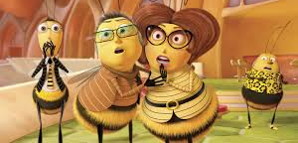
In Conclusion (Bee concerned, honey!)
Colonies continue to die at an alarming rate More study is needed

Slide 30
5 Simple, Easy Actions
Support the Bee Informed Partnership https://beeinformed.org/donate/
Write or call the USDA - The department will suspend data collection for its Honey Bee Colonies report, and officials did not say when — or if — it would be restarted The Agricultural Department has been a key source of data on the insects, which is critically important to scientists and farmers.
https://www.usda.gov/contact-us
Plant a garden with local and native flowers
Lighten your pesticide usage
Become a beekeeper!!
https://www.osbeehives.com/

Slide 31


With special thanks to:
Guy
Bethany
Alexander
Louis

Slide 32
Backup

Slide 33
In case you’re wondering…
Bee Movie images: meets fair use as outlined in §107 of the Copyright Act: the purpose and character of the use, including whether such use is of a commercial nature or is for nonprofit educational purposes
Bee Informed Partnership supports the reproduction and reuse of these results, publications and figures for scientific and educational purposes, at no cost, provided that BIP’s ownership, copyright and non-endorsement status are acknowledged ( see references slide 7)

Slide 34
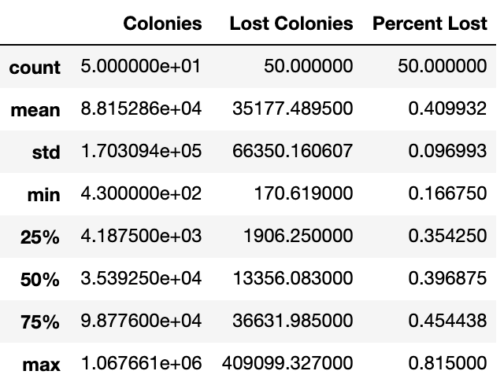
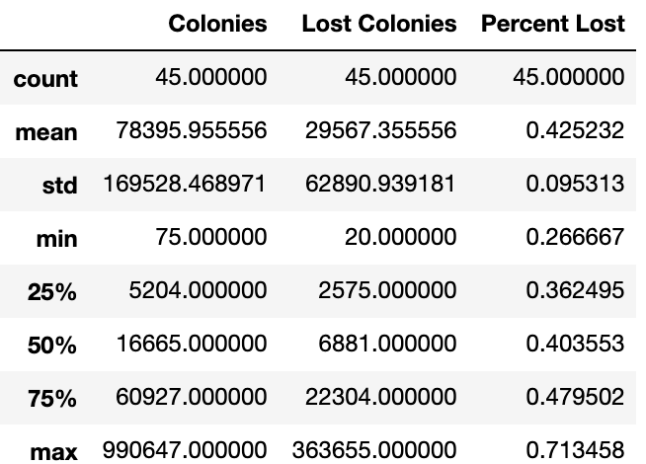
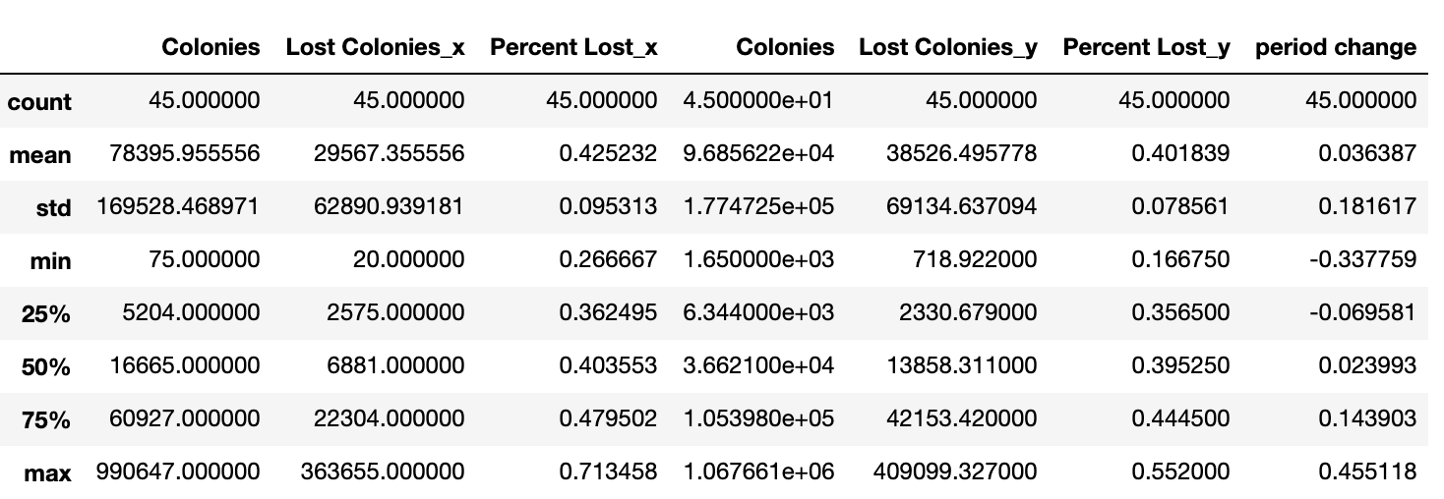
Bee data tables
2011 - 2014
2015-2018
All

Slide 35
Data Sets
Link to description of most data sets HERE
Data constraints:
Lack of open source data where it was possible to measure similar attributes and therefore more granular views are not possible ( as such as location ( long/lat/county vs states only), timeframes ( month vs year only), and data collection methods (survey vs crowdsourced only)

